Slide 1

External Project Presentation of Computer Networking(CSE 3034) on TIC TAC TOE
Presented by
SHAIKH SHOHAIL PARWEJ(2141016146)
SUBHAKANKHI SWAIN (2141019409)
DHRUB KHATRY(2141011043)
DEBOPAM AICH(2141001033)
SUCHARITA BARIK (2141002145)
Supervisor
Respected
Mr. Jyotiranjan Panda
(Asstociate Professor , ITER ,SOA)
Department of Computer Science and Engineering
Institute of Technical Education & Research (FET)
Siksha ‘O’ Anusandhan Deemed to be University, Bhubaneswar
Jan, 2024

Slide 2


Contents
Introduction
Problem statement
Methodology
Implementation
Result and Interpretation
Conclusion
LETS PLAYYYYYY
HURAYYYY
LETSS GOOO

Slide 3
Introduction
"Tic Tac Toe Network Programming in Java" showcases the successful implementation of a networked multiplayer game using Java's socket programming capabilities. This project not only demonstrates technical proficiency in network communication but also underscores the importance of user-centered design and efficient coding practices. It serves as a foundation for further exploration into networked game development and real-time applications.
The project involves the use of Java's socket programming capabilities to establish a client-server architecture. The server acts as an intermediary, facilitating communication between the two players. The clients connect to the server using sockets, enabling data exchange and game coordination.

Slide 4
Problem Statement
AIM: Develop a console-based client-server application for a two-player Tic Tac Toe game. (use Java Programming)
EXPLANANTION OF THE PROBLEM: Develop a console-based client-server application for a two-player Tic Tac Toe game using Java programming. The application should allow users to interact through the console by entering moves for the Tic Tac Toe game. The result of each move and the overall game progress should be reflected in the form of file content or database entries displayed in the console.
CONSTRAINTS:
The application must be implemented in Java.
It should follow a client-server architecture.
The game should be a two-player Tic Tac Toe.
Console-based interaction is required for user moves and game progress.
The game progress should be reflected either in file content or in a database, also displayed in the console

Slide 5

Methodology
STEP 1:
System Requirements: To successfully run the Tic Tac Toe Network Game, ensure you have the following: -
Two computers connected to the same network.
Java Development Kit (JDK) installed on both computers.
Basic familiarity with running Java applications.
STEP 2:
Setup:
In the "Server" folder, write the server-side code. In the "Client" folder, write the client side.
STEP 3:
Running the Server: Run the server code and Note down the IP address and port number displayed on the server console.

Slide 6
Methodology
STEP4:
Running the Client: Run the client code and enter the IP address and port number obtained from the server console. The client will attempt to connect to the server.
STEP5:
Gameplay: The player running the server goes first. Moves are sent to the opponent's screen in real-time. The game alternates between players' turns automatically. Messages will indicate whose turn it is and the game status.
STEP6:
Winning and Drawing: The game will recognize when a player wins by having three symbols in a row, column, or diagonal. If all cells are occupied and no player has won, the game ends in a draw.
STEP7:
Ending the Game: When the game concludes, a message will display the winner or a draw on both screens. To start a new game, close the current application and run it again.
Enjoy the Game Congratulations!
You are now ready to enjoy the Tic Tac Toe Network Game.!!!

Slide 7
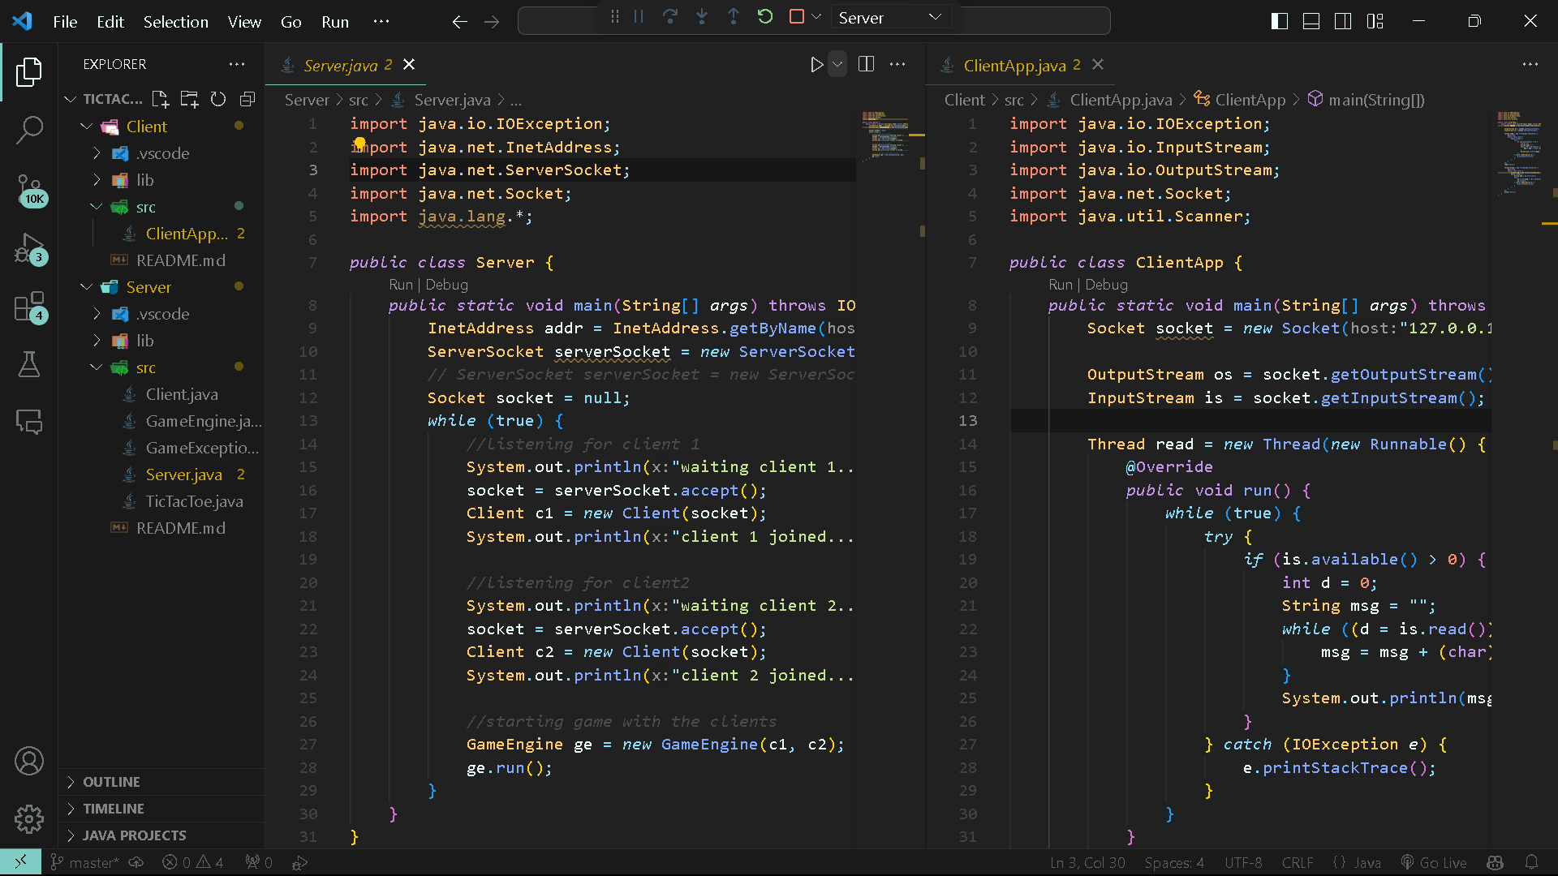
Implementation

Slide 8
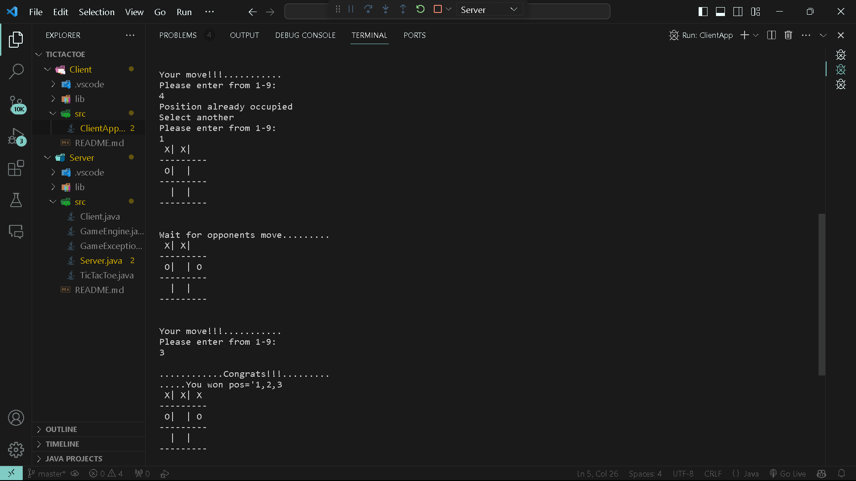

Result and Interpretation
Tic Tac Toe is a classic two-player game played on a 3x3 grid. Players take turns marking an empty cell with their symbol, usually "X" for one player and "O" for the other, aiming to get three of their symbols in a row, either horizontally, vertically, or diagonally, to win the game. If all cells are filled without either player achieving a winning pattern, the game ends in a draw. It's a simple yet engaging game that often serves as an introductory example in teaching game theory and strategy.
Here, we need to connect both the laptop using the same IP addresses and port number to establish a connection and play with game
PICTURE: CODE GAMEPLAY OF TIC TAC TOE BETWEEN TWO PLAYERS

Slide 9
Conclusion
The project demonstrated the successful implementation of a networked Tic Tac Toe game, allowing players to compete against each other remotely. The game's core mechanics were faithfully retained, while the addition of network functionality added a dynamic and competitive layer.
In conclusion, the networked Tic Tac Toe project provided an engaging and educational exploration into the realm of game development, networking, and user experience design. The project's accomplishments underscore the importance of innovative thinking, technical competence, and adaptability in the ever-evolving landscape of technology. As the project paves the way for future enhancements and applications, it stands as a testament to the creative potential and limitless possibilities that lie at the intersection of gaming and technology.

Slide 10
References
[1] A. S. Tannenbaum, "Computer Networks," Pearson India.
[2] H. Harold, "Java Network Programming," O’Reilly, Shroff Publishers.
[3] W. Richard Stevens, "TCP/IP Illustrated, Volume 1: The Protocols," Addison-Wesley Professional.
[4] G. G. Richard Stevens, "UNIX Network Programming," Prentice Hall.
[5] D. E. Comer, "Internetworking with TCP/IP: Principles, Protocols, and Architecture," Prentice Hall.

Slide 11

ANY QUESTIONS

Slide 12

THANK YOU

